Slide 1

PATTERN RECOGNITION LECTURE 1 introduction
Dr. Umarani Jayaraman
Assistant Professor

Slide 2
What is a pattern?
A pattern is either a physical object or an abstract notion
A book, chair, biometric fingerprints are physical object
Style of walking/talking/ writing and hand gesture pattern corresponds to an abstract notion.
Abstract notion is also called as an event or a process.

Slide 3
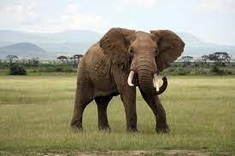
What is a pattern?
A pattern is a physical object or an abstract notion
If we are talking about the classes of animals then a description of an animal would be a pattern
Big animal
Has four legs
Big ears
Long trunk
A pair of tusks
……

Slide 4

What is a pattern?
If we are talking about classes of balls, then a description of a ball is a pattern
Size
Color
Shape
Weight
….

Slide 5
What is a pattern?
These patterns are represented by a set of descriptions also known as attributes and features
If we want to distinguish the animals from balls features of the patterns are used.

Slide 6
Pattern – Book Definition
A pattern is the representation of an object by the values taken by the set of attributes/features.

Slide 7
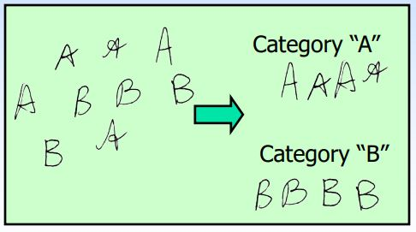
Pattern Recognition
Input: Given a pattern
Output: Identification of a pattern as a member of a category/class we already know or we are familiar with.
Classification (known categories)

Slide 8
Classification
In the classification problem, we have a set of objects for which the values of the features/attributes are known.
We have a set of classes and each object belongs to one of these classes
The classes for the case of animal and balls the patterns are known and it is different
Given a new pattern, the class of the pattern is to be determined.

Slide 9
Classification - challenges
The representation of patterns (choice of attributes) is a very important step in pattern classification
A good representation is one which makes use of discriminating attribute and also reduces the computational cost in pattern classification

Slide 10
Pattern Recognition
Cognition is the act of seeing or perceiving, whereas recognition means as having seen or perceived.

Slide 11

Example of cognition

Slide 12
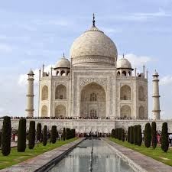
Example of recognition

Slide 13
Example of pattern recognition tasks
Reading facial expression
Recognizing speech
Reading a document
Identifying a person by fingerprints
Diagnosis from medical images
Wine tasting

Slide 14
Human recognition of pattern
A basic attribute of people/human is categorization of sensory input
PR System
Pattern
Class Label
Neural and cognitive systems (Natural Intelligence)

Slide 15
Human recognition of pattern
We recognize a face, understand spoken words, read handwritten characters, decide whether a banana is ripe by its smell- all these complex processes that underlie the acts of pattern recognition.
Pattern recognition- The act of taking in raw data and making an action based on the “category” of the pattern- has been crucial for our survival and
Over the past tens of millions of years we have evolved highly sophisticated neural and cognitive systems for such tasks.

Slide 16
Machine recognition of patterns
Artificial Intelligence: It tries to transfer the natural intelligence of human to machine by using algorithms/theory/models
PR System
Pattern
Class Label
Algorithms/Theory/Models
(Artificial Intelligence)

Slide 17
Machine recognition of patterns
Feature extractor makes some measurements on the input pattern
X is called feature vector, often X ϵ R^{d}
Classifier maps each feature vector to a class label
Features to be used are problem specific
Feature Extractor
X
Classifier
Pattern
Class Label

Slide 18
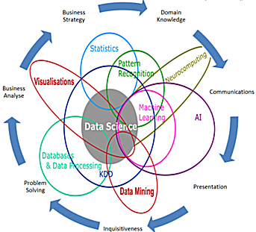
Relationship with other field

Slide 19
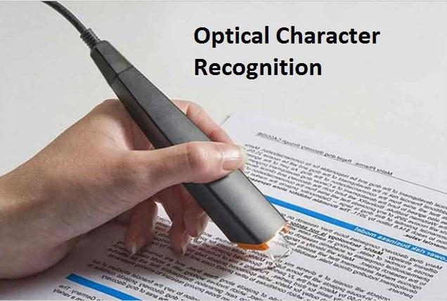
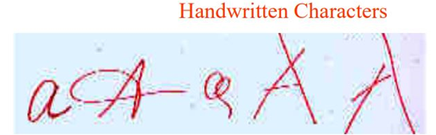
Some examples of PR Tasks
1. Character recognition (OCR)
Pattern-Image
Class- Identifying of character
Features- binary image, projects, moments, etc

Slide 20
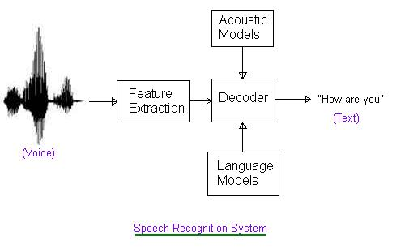
Some examples of PR Tasks
2. Speech recognition
Pattern- 1D signal
Class-Identifying of speech units
Features- spectral info, cepstrum, etc.
Patterns can become a sequence of features vectors

Slide 21
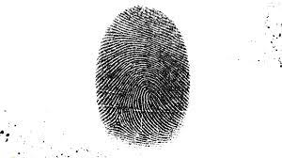
Some examples of PR Tasks
3. fingerprint based Identity verification
Pattern- Image + Identity claim [login ID]
Class- yes/ no
Features- minutiae, orientation of ridge lines, pores, etc

Slide 22
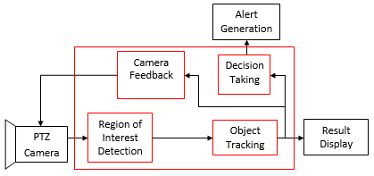
Some examples of PR Tasks
4. video based surveillance
Pattern- Video sequence
Class- level of alertness
Features – motion trajectories, parameters if pre fixed models, etc

Slide 23
Some examples of PR Tasks
5. Credit screening
Pattern –details of an applicant (eg. credit card)
Class- yes/no
Features- Income, job history, credit history, etc

Slide 24
Some examples of PR Tasks
6. Imposter detection
Pattern- A sequence of transaction (credit card)
Class – yes/ no
Features- amount of money, location of transaction, etc.

Slide 25
Some examples of PR Tasks
7. Document Classification
Pattern- A documents and a query
Class- relevant or not (rank them)
Features – word occurrences, word context, etc.

Slide 26
Some examples of PR Tasks
8. Spam filtering
Pattern- A sequence of mail
Class- relevant or not (important mail)
Features – source address, content of mail, word context, word occurrences, etc.

Slide 27
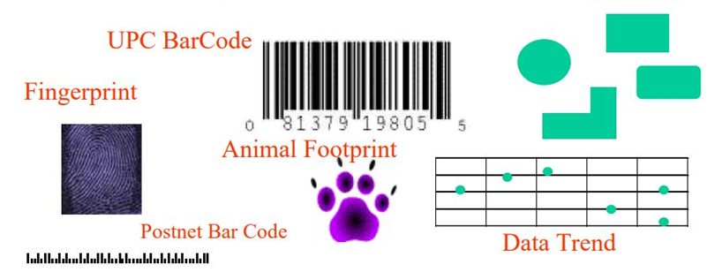
Examples of more patterns

Slide 28
Summary
Natural Intelligence: The real power of human thinking is based on recognizing patterns.
Artificial Intelligence: The better machine/computers get at ‘pattern recognition’, they will act like human.
Artificial Intelligence (AI) is the field of transferring the natural intelligence of human into machine so that it take decision as like human.

Slide 29
Thank you

